Slide 1

ATM Security System Using Acoustic AI
Mini-Project Final Review
Team Members:
ABISHEK A - 122012012838
KUBANDRA GUPTHA J - 122012012806
RAHMAN N - 122012012892
VARUN R -122012012890
Project Guide : Dr. M. Sharmila Begum Professor / CSE

Slide 2
Introduction
The Context: ATMs are critical infrastructure but vulnerable to physical attacks like drilling, cutting, and smashing.
The Concept: An intelligent security layer that "listens" to the environment.
The Solution: We use Deep Learning (CRNN) to analyze audio in real-time, distinguishing specific threat signatures from background noise.
Key Benefit: Proactive detection (triggering *during* the attack) rather than reactive recording (CCTV).
References

Slide 3

Problem Statement
Video Blind Spots
Sensor Limitations
Real-Time Delay
CCTV cameras are reactive, not preventive. They cannot cover all angles, and subtle attacks like precise drilling may not be immediately obvious on a video feed.
Traditional sensors (vibration, heat) suffer from high false alarm rates. They can be triggered by innocent sources like heavy trucks or construction, leading to alert fatigue.
Most breaches are detected *after* they occur. A system is needed to identify a threat *during* the act, minimizing financial loss and response time.
Questions?

Slide 4

Objectives
Data Curation: Aggregated and preprocessed industrial threat sounds and real-world environmental background noises to simulate ATM acoustic conditions.
Feature Extraction: Applied MFCC algorithms to convert raw audio into meaningful spectral features for model training.
Model Architecture: Built and validated a Hybrid CRNN combining CNN for spectral learning and RNN for temporal pattern recognition.
Optimization: Improved robustness using Gaussian noise–based data augmentation to achieve over 90% detection accuracy.
System Deployment: Implemented a Streamlit dashboard enabling real-time audio processing, classification, and visual threat alerts.
References
Questions?

Slide 5


Literature Review / Existing Systems
Existing Physical Security
Academic Gap
Lack of lightweight, edge-optimized hybrid audio models suitable for low-power ATM kiosk hardware like Raspberry Pi.
Limited research on temporal-rhythmic pattern recognition using RNNs to distinguish real attack signatures from urban noise.
Absence of strong data augmentation strategies to compensate for sparse real-world ATM attack audio datasets.
Limited development of real-time acoustic forensics integrated with user-friendly dashboards for live ATM monitoring.
Inadequate focus on reducing false positives in noisy urban environments with similar-sounding “hard negative” audio events.
Over-reliance on single-modal architectures instead of hybrid spatial-temporal CRNN models tailored for physical security detection.
AI-enabled smart energy meters with edge computing offer real-time decision-making and reduced latency.
Personalized Federated Learning improves building-level energy forecasting while preserving data privacy.
Explainable AI techniques like SHAP enhance interpretability in deep learning–based anomaly detection systems.
Optimized XGBoost models provide high-speed and accurate anomaly detection in SCADA-based smart grids.
Classical ML models (Isolation Forest, One-Class SVM, Random Forest) are effective for detecting electricity theft in Indian energy datasets.
For quasi-periodic energy data, simpler statistical/ML models can outperform complex deep learning methods depending on dataset characteristics.
Questions?

Slide 6
Proposed System Methodology
4. Training
2. Extraction
A Hybrid CRNN (CNN + Bidirectional RNN) is trained to find temporal patterns in the fingerprints.
Audio standardized to 4s and converted to MFCC Spectrograms ("sound fingerprints").
1. Data Prep
3. Augmentation
Automated script sorts 1,213+ clips from 5 sources into `Normal` (0) and `Anomaly` (1).
Gaussian Noise added to training data, doubling the set to 1,940 samples to prevent overfitting.
Salamon, J., et al. (2014). "A Dataset and Taxonomy for Urban Sound Research (UrbanSound8K)." 22nd ACM International Conference on Multimedia.
Adavanne, S., et al. (2017). "Sound event detection using spatial and harmonic features with 2D-CNN."

Slide 7
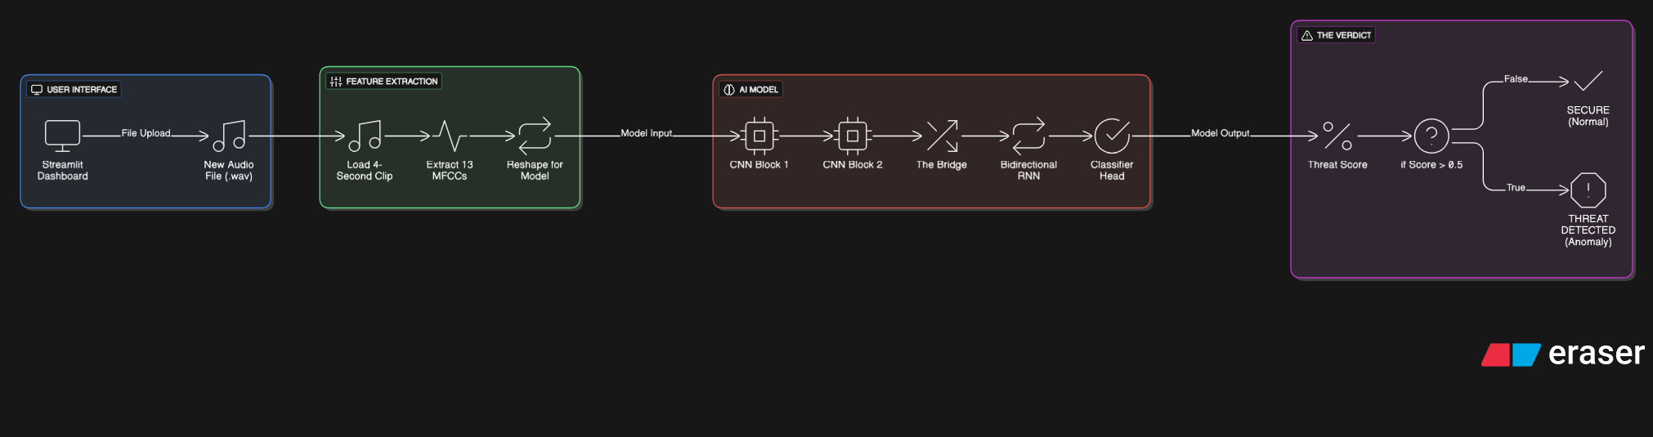
System Architecture
1. The "Eye" (CNN)
2. The "Bridge" (Reshape)
Two `Conv2D` layers (64 & 128 filters) scan the MFCC "image" for textures and harmonic shapes.
A `Permute` + `Reshape` layer flips the data to be read chronologically, from left to right.
3. The "Brain" (RNN)
4. The Output (Classifier)
A `Bidirectional(SimpleRNN)` layer "listens" to the sound's context. It understands not just the *sound* of a drill, but the *sound of drilling over time*.
A `Dense` layer with a `Sigmoid` function gives a final probability score between 0 (Normal) and 1 (Anomaly).
References

Slide 8
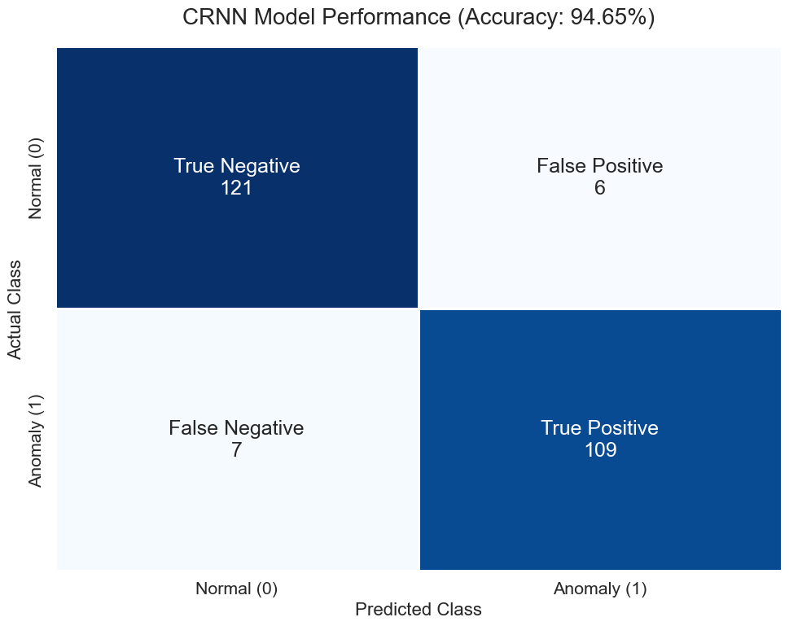
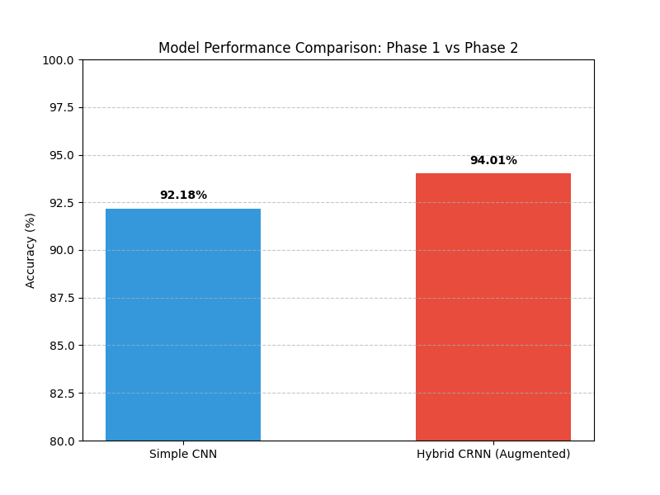
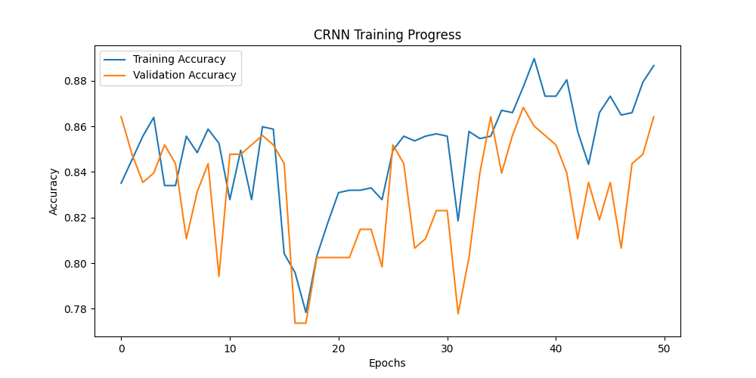
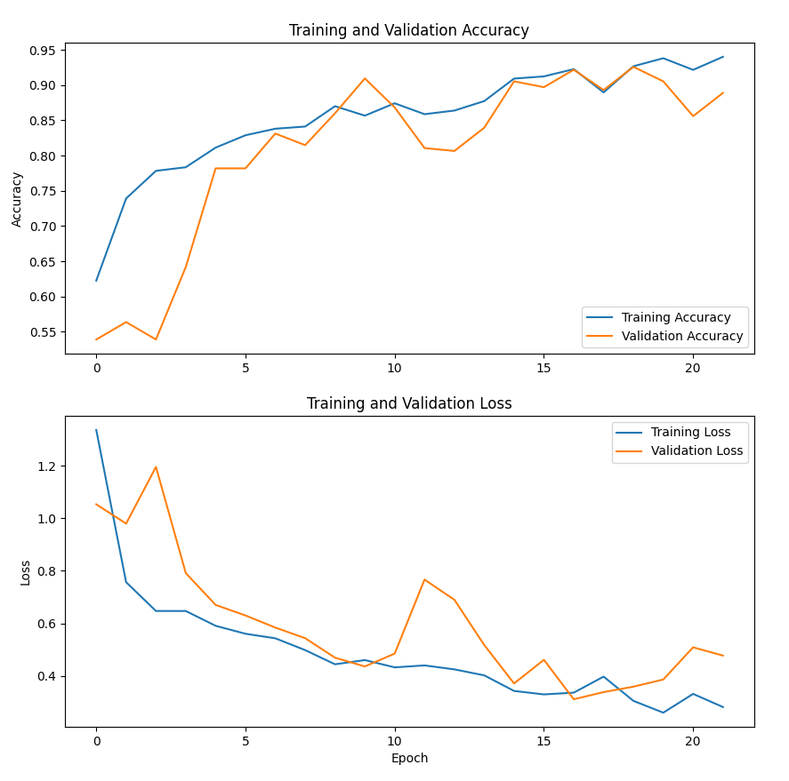
Results, Analysis & Screenshot
Confusion Matrix
Shows how the model classified 243 test samples.
109 True Positives: Correctly identified threats (Drilling/Sawing).
121 True Negatives: Correctly identified normal sounds (Traffic/AC).
Low Errors: Only 6 false alarms and 7 missed threats, proving high reliability.
CNN Training Performance:
Tracks the learning process of the initial Baseline CNN.
Blue (Training) and Orange (Validation) lines rise smoothly together.
Indicates stable learning with minimal overfitting, peaking around 92% accuracy.
Model Comparison:
Compares the final accuracy of the two architectures.
Blue Bar: Simple CNN achieved 92.18%.
Red Bar: Hybrid CRNN (Augmented) achieved 94.01%.
Shows a clear 1.83% improvement by adding RNN layers and data augmentation.
CRNN Training Progress:
Tracks the training of the advanced Hybrid CRNN.
Jagged Orange Line: The validation accuracy fluctuates significantly, which is normal for complex models learning temporal patterns on small datasets.
Result: Despite the volatility, it ultimately reaches a higher peak accuracy than the CNN
Questions?

Slide 9
Conclusion & Future Work
Conclusion: We successfully designed and trained a Hybrid CRNN model capable of detecting acoustic ATM threats with 94.65% accuracy.
Conclusion: Data Augmentation (Gaussian Noise) was critical in preventing overfitting and pushing accuracy past the baseline CNN.
Future Work: Deploy the model on low-power hardware (like a Raspberry Pi) for cost-effective, real-world implementation.
Future Work: Expand the dataset with more diverse "Normal" sounds (e.g., vacuum cleaners, different music) to further reduce false alarms.
Questions?

Slide 10
References
[1] K. J. Piczak, "Environmental sound classification with convolutional neural networks," in 2015 IEEE 25th International Workshop on Machine Learning for Signal Processing (MLSP), Boston, MA, USA, 2015, pp. 1–6.
[2] J. Salamon and J. P. Bello, "Deep Convolutional Neural Networks and Data Augmentation for Environmental Sound Classification," IEEE Signal Processing Letters, vol. 24, no. 3, pp. 279–283, March 2017.
[3] S. Adavanne, P. Pertilä, and T. Virtanen, "Sound event detection using spatial and harmonic features with 2D-CNN," in 2017 IEEE Workshop on Applications of Signal Processing to Audio and Acoustics (WASPAA), New Paltz, NY, USA, 2017, pp. 261–265.
[4] V. Lemaire, O. Y. Al-Jarrah, and A. Al-Dmour, "Acoustic Surveillance of Hazardous Situations Using Deep Learning," IEEE Access, vol. 7, pp. 24343–24352, 2019.
[5] R. Kumar and S. Shreyas, "An Intelligent ATM Security System using IoT and Deep Learning," International Journal of Engineering Research & Technology (IJERT), vol. 9, no. 6, pp. 45–49, June 2020.
[6] E. Cakir, G. Parascandolo, T. Heittola, and T. Virtanen, "Convolutional Recurrent Neural Networks for Polyphonic Sound Event Detection," IEEE/ACM Transactions on Audio, Speech, and Language Processing, vol. 25, no. 6, pp. 1291–1303, June 2017.

Slide 11
Thank You

